Slide 1
11/16/2022
Quiz 3: Molecular Simulations
Innovation Day
Quantitative Structure-Property Relationships

Slide 2

FALL 2022 INNOVATION DAY
OVERVIEW

Slide 3
At the Kaplan Institute, we understand that practical, technological breakthroughs only come from people who are not just good at technology, but good at leadership: people who understand that influence, inspiration and human insight are as important as engineering and computer science and clean rooms; people who are looking to drive positive change, both in their communities and in the world, and see technology as the means.
The Innovation Day presentation is in effect the final exam for IPRO projects. The presentations demonstrate the entire development process requiring teams to assemble all work done over the course of the semester and present that work to the partners in person.
Innovation Day Overview

Slide 4
In order for us to be able to develop exhibit materials as well as distribute content with our partners, all teams must submit their project deliverables by November 30. The deliverables may include the following:
Innovation Day Deliverables
Presentation Slide Deck
Research Deck and/ or Written Report
Supporting Media/ Documentation
(Poster, Videos/ Animations/ Renderings/ Documentation of Prototypes)
Please submit all relevant project materials using the following the link below:
Team Submission
Innovation Day Project Submission

Slide 5
Innovation Day: Friday, Dec. 2nd
8:00 - 9:00 AM
Team setup
9:30 - 12:30 PM
Doors open/ Judging begins
12:30 - 1:30 PM
Judges’ deliberation & lunch
1:30 PM -2:00 PM
Recognition ceremony
Innovation Day Schedule

Slide 6
Sustainable Cities
Community and Social Innovation
Sports and Technology
Competitions
Research
Innovation Day Judging Tracks

Slide 7

COMMITMENT TO POSITIVE COMMUNITY CHANGE | Did the team identify and analyze a contemporary issue and problem? Did the team address and compare different perspectives, both within and across cultures?
CRITICAL AND INNOVATIVE THINKING | Did the team appropriately employ multiple quantitative and qualitative methods of analysis and evaluation? Did the team employ the best available technology to achieve the solution(s)?
PROFESSIONAL AND ETHICAL COLLABORATIONS | Did the team members successfully work with others within disciplines and cultures? Did the team identify and discuss ethical issues?
EFFECTIVE COMMUNICATION | Did the team speak and write appropriately within and across disciplines and cultures? Did the students present their project in clear, concise, and logical form both verbally and through visual/graphic supporting material? Did the team clearly establish an objective and cohesively support it?
Judging Rubric
Click here for the evaluation form

Slide 8

Each team will have approximately 2’ x 3’ of table space with access to power.
Your team needs to be able to stand out. Build prototypes!!!
Bring your own displays (computer monitors or televisions) for more visuals.
Please have your students fill out this form for special requests regarding equipment/space needs.
Exhibition Space

Slide 9
Design all graphics for 24” x 36” layout. Do NOT scale up from a smaller page size
Use no less than 24pt font
Print a black and white full size version to mockup, then adjust image sizes and fonts as needed
Check all spelling BEFORE you print
Send files to the Post Office Mail Center at MTCC
Poster Guidelines & Best Practices

Slide 10
The IPRO office is offering vouchers for teams to print 24” x 36” posters that can be mounted to foam core.
Please visit the Kaplan Welcome Desk or the IPRO Help Desk for a voucher to print your poster at the MTCC Post Office (2 vouchers/team).
Vouchers will become available from November 9th onwards.
Foam core will be available at the Idea Shop from the week of November 14th.
Poster Printing

Slide 11
Event
Deadlines
& Requests
Teams should fill out this request form by Friday, November 25 for any special requests for Innovation Day. We cannot honor any requests made after that date.
Teams are required to submit their project deliverables by Wednesday November 30th here.
Teams must have their project space set up by 9 AM on Friday, December 2nd.

Slide 12
Make A Plan
Envision the experience you wish to deliver, what is the sequence of movements, and set goals for that.
Visualize
Imagine the exhibition space, then sketch out how you plan to set up your table. How will you display your visuals, prototypes etc.
Practice
What is the story you want to tell, how do you want the audience to feel and react. Presentations need to be 3-5 minutes.
Work With Your Professors
Professors can help determine ways to best portray your work
Divide & Conquer
Everyone on the team needs to contribute, work to each others strengths.
Prepping For
Innovation Day

Slide 13
Video & media is a great medium to tell your story and illicit emotion
Remember audio will be hard to hear on Innovation Day
Videos & animations can effectively demonstrate functions of your concept
*Videos/ Media is not required for Innovation Day
Using Video & Multimedia

Slide 14
Resources

Slide 15
IPRO Office Resources
Supplies and Purchasing
https://ideashop.iit.edu/portal/
https://ipro.iit.edu/class-resources/
Software on Campus
https://ots.iit.edu/classrooms-labs/lab-software
https://wiki.ideashop.iit.edu/index.php?title=Computer_Software

Slide 16
Visual Assets
Icons
● The Noun Project: https://thenounproject.com
● Font Awesome: https://fontawesome.com/icons?d=gallery
● Dryicons: http://dryicons.com/free-icons/
● FREEBIESBUG: http://freebiesbug.com/psd-freebies/icons/
Free Imagery - Photography
● UNSPLASH: https://unsplash.com
● PixaBay: https://pixabay.com
● Free Images: http://www.freeimages.com
● PEXELS: https://www.pexels.com
● PICJUMBO: https://picjumbo.com
● PixaBay: https://pixabay.com

Slide 17
Visual Assets
Video Clips (Free - select ones on sites)
● https://www.wedistill.io/
● https://coverr.co/
● https://www.pexels.com/
● https://pixabay.com/
● https://www.videvo.net/
● https://www.videezy.com/
● https://www.vidsplay.com/
● https://mazwai.com/
More generic, aerial & drone shots:
● https://www.lifeofvids.com/
● https://dareful.com/
● https://www.splitshire.com/

Slide 18
Interaction Design Tools
Figma: https://www.figma.com/
Figma for beginners: https://www.youtube.com/watch?v=Saz6S1svYns
Sketch: https://www.sketch.com/
A guide to sketch basic: https://www.youtube.com/watch?v=qywB0JHQeC4
Mockplus: https://www.mockplus.com/
Mockplus Tutorial: https://www.youtube.com/watch?v=LGZDZ-L0ejo
Adobe XD (can use from Idea Shop at Kaplan: Ideashop Link)
Top ten things to know when getting started with Adobe XD: https://www.youtube.com/watch?v=JttI6YpmPGI

Slide 19
Examples for Innovation Day

Slide 20
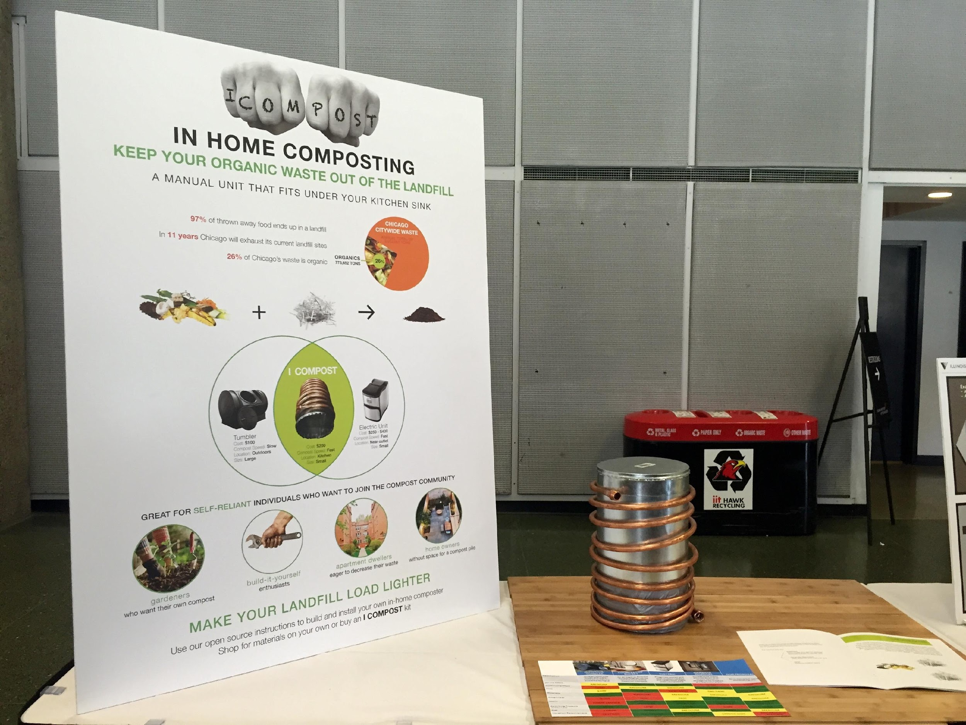

Slide 21
What is it? & Concisely states problem
Strategy
(this team included cost here bc it was DIY)
Support problem
Who? & benefits
Why ?
How?

Slide 22
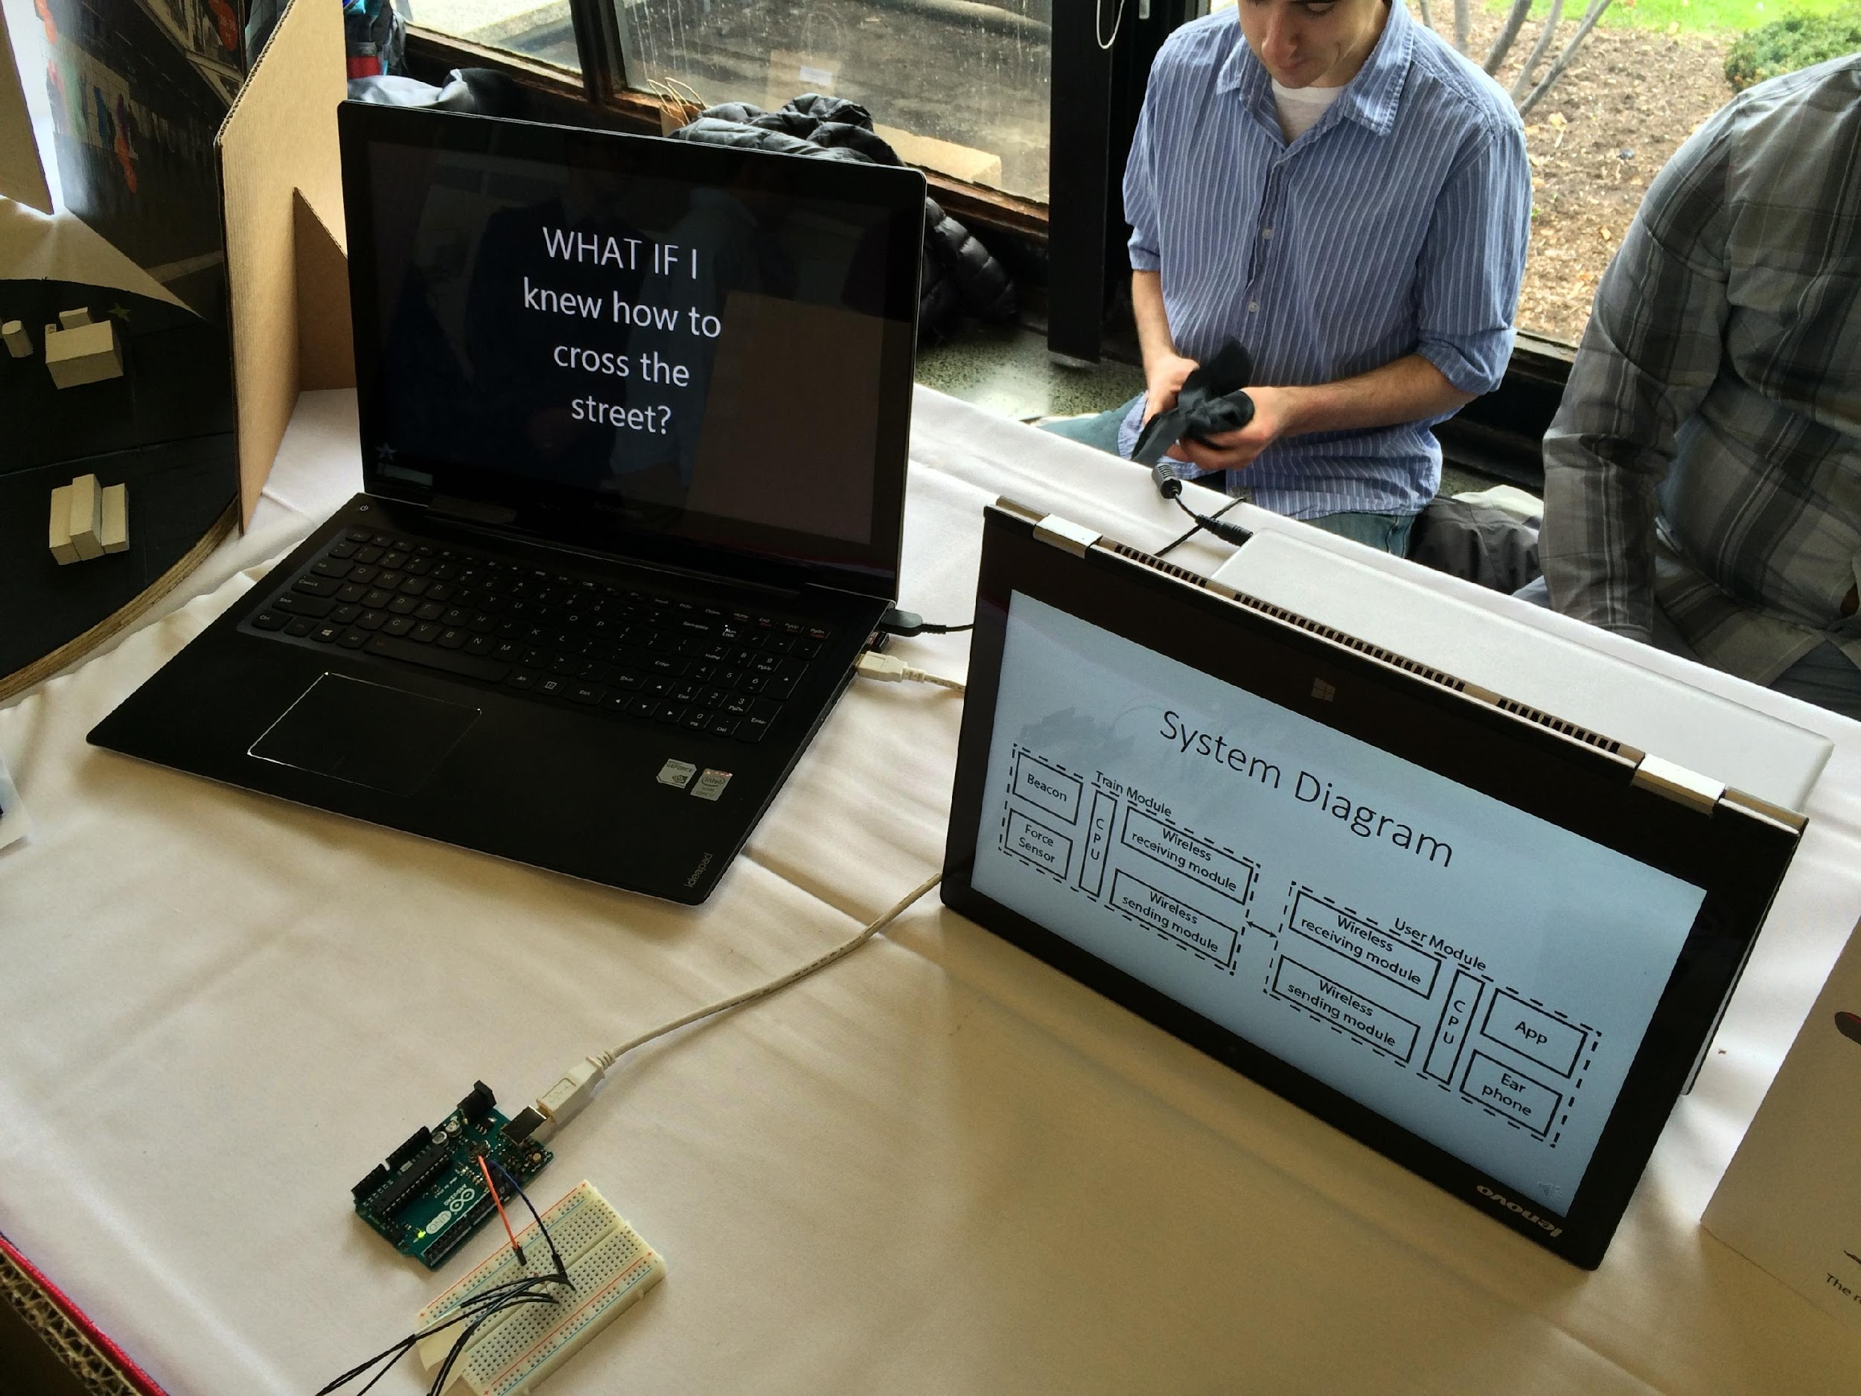

Slide 23
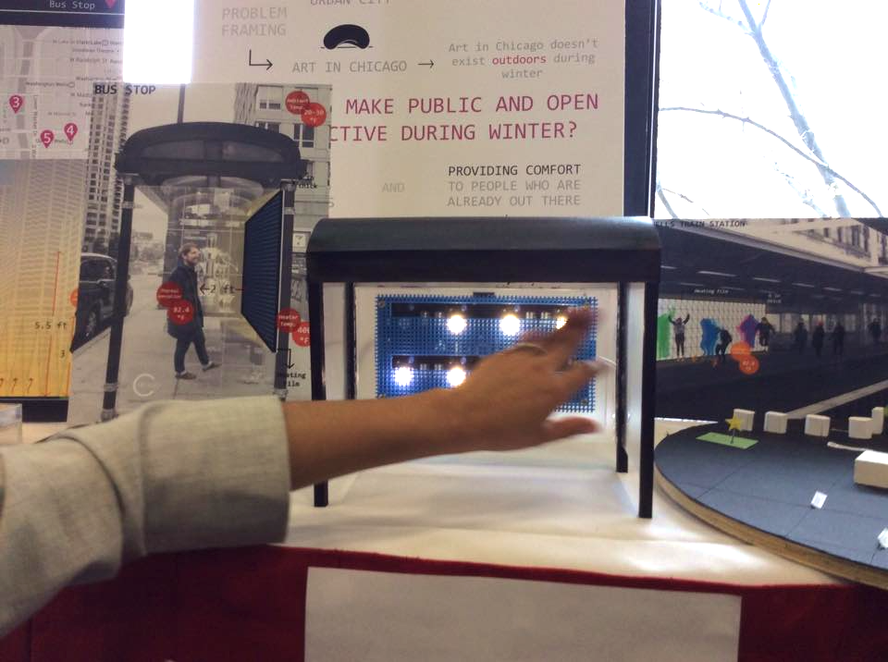

Slide 24
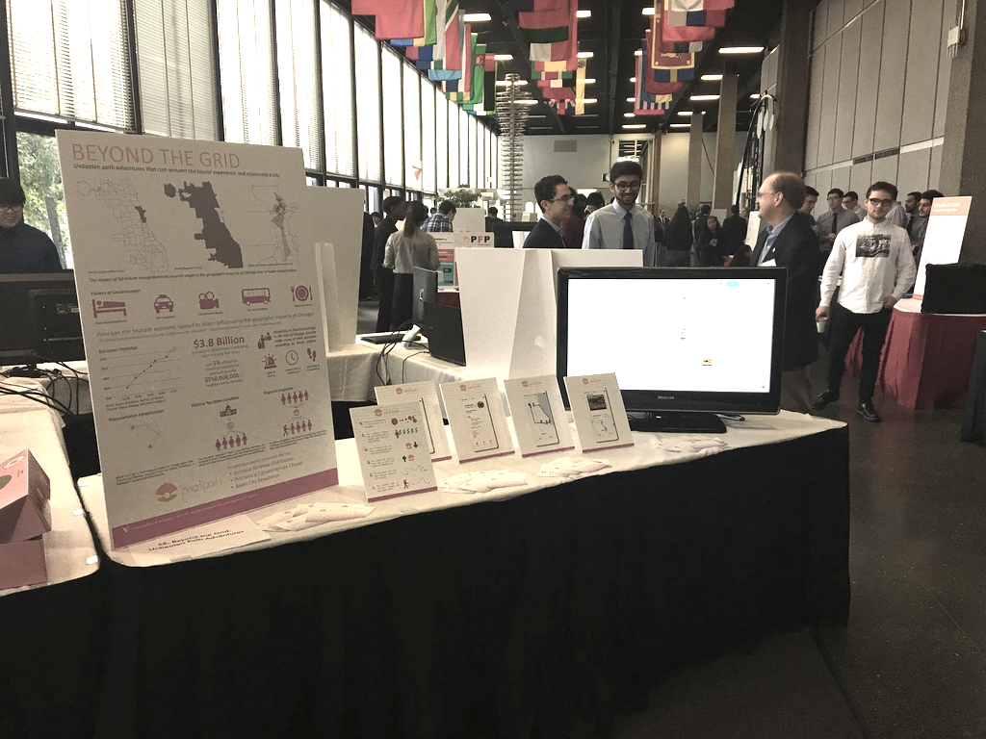

Slide 25
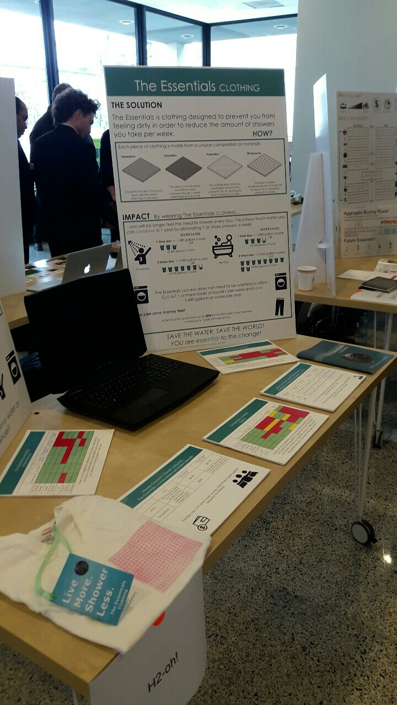
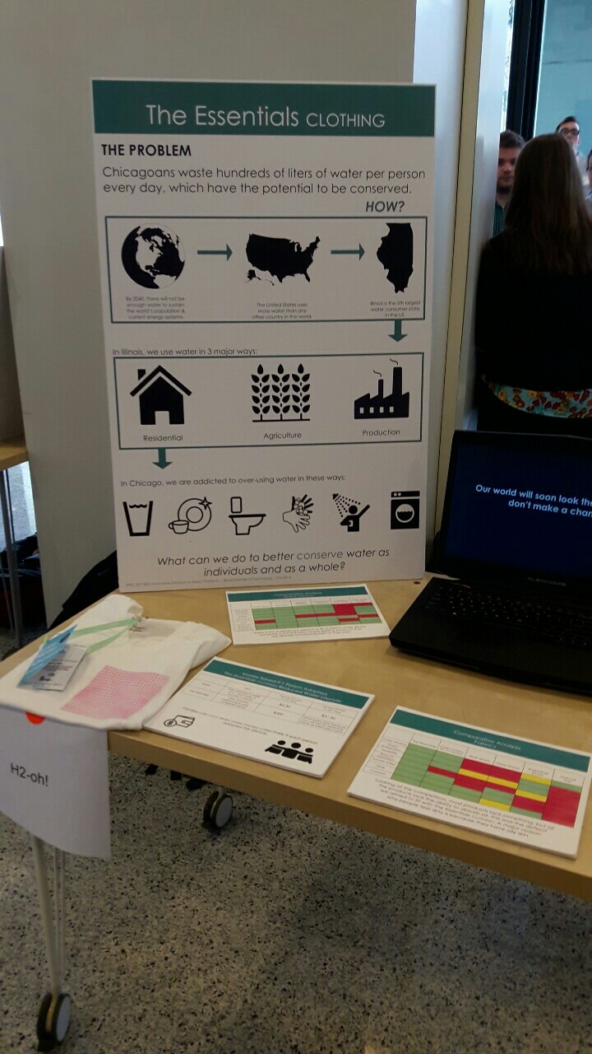

Slide 26
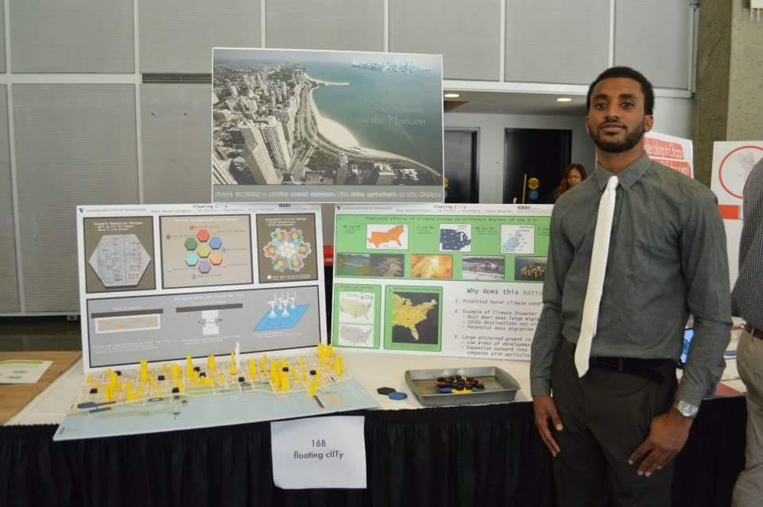

Slide 27
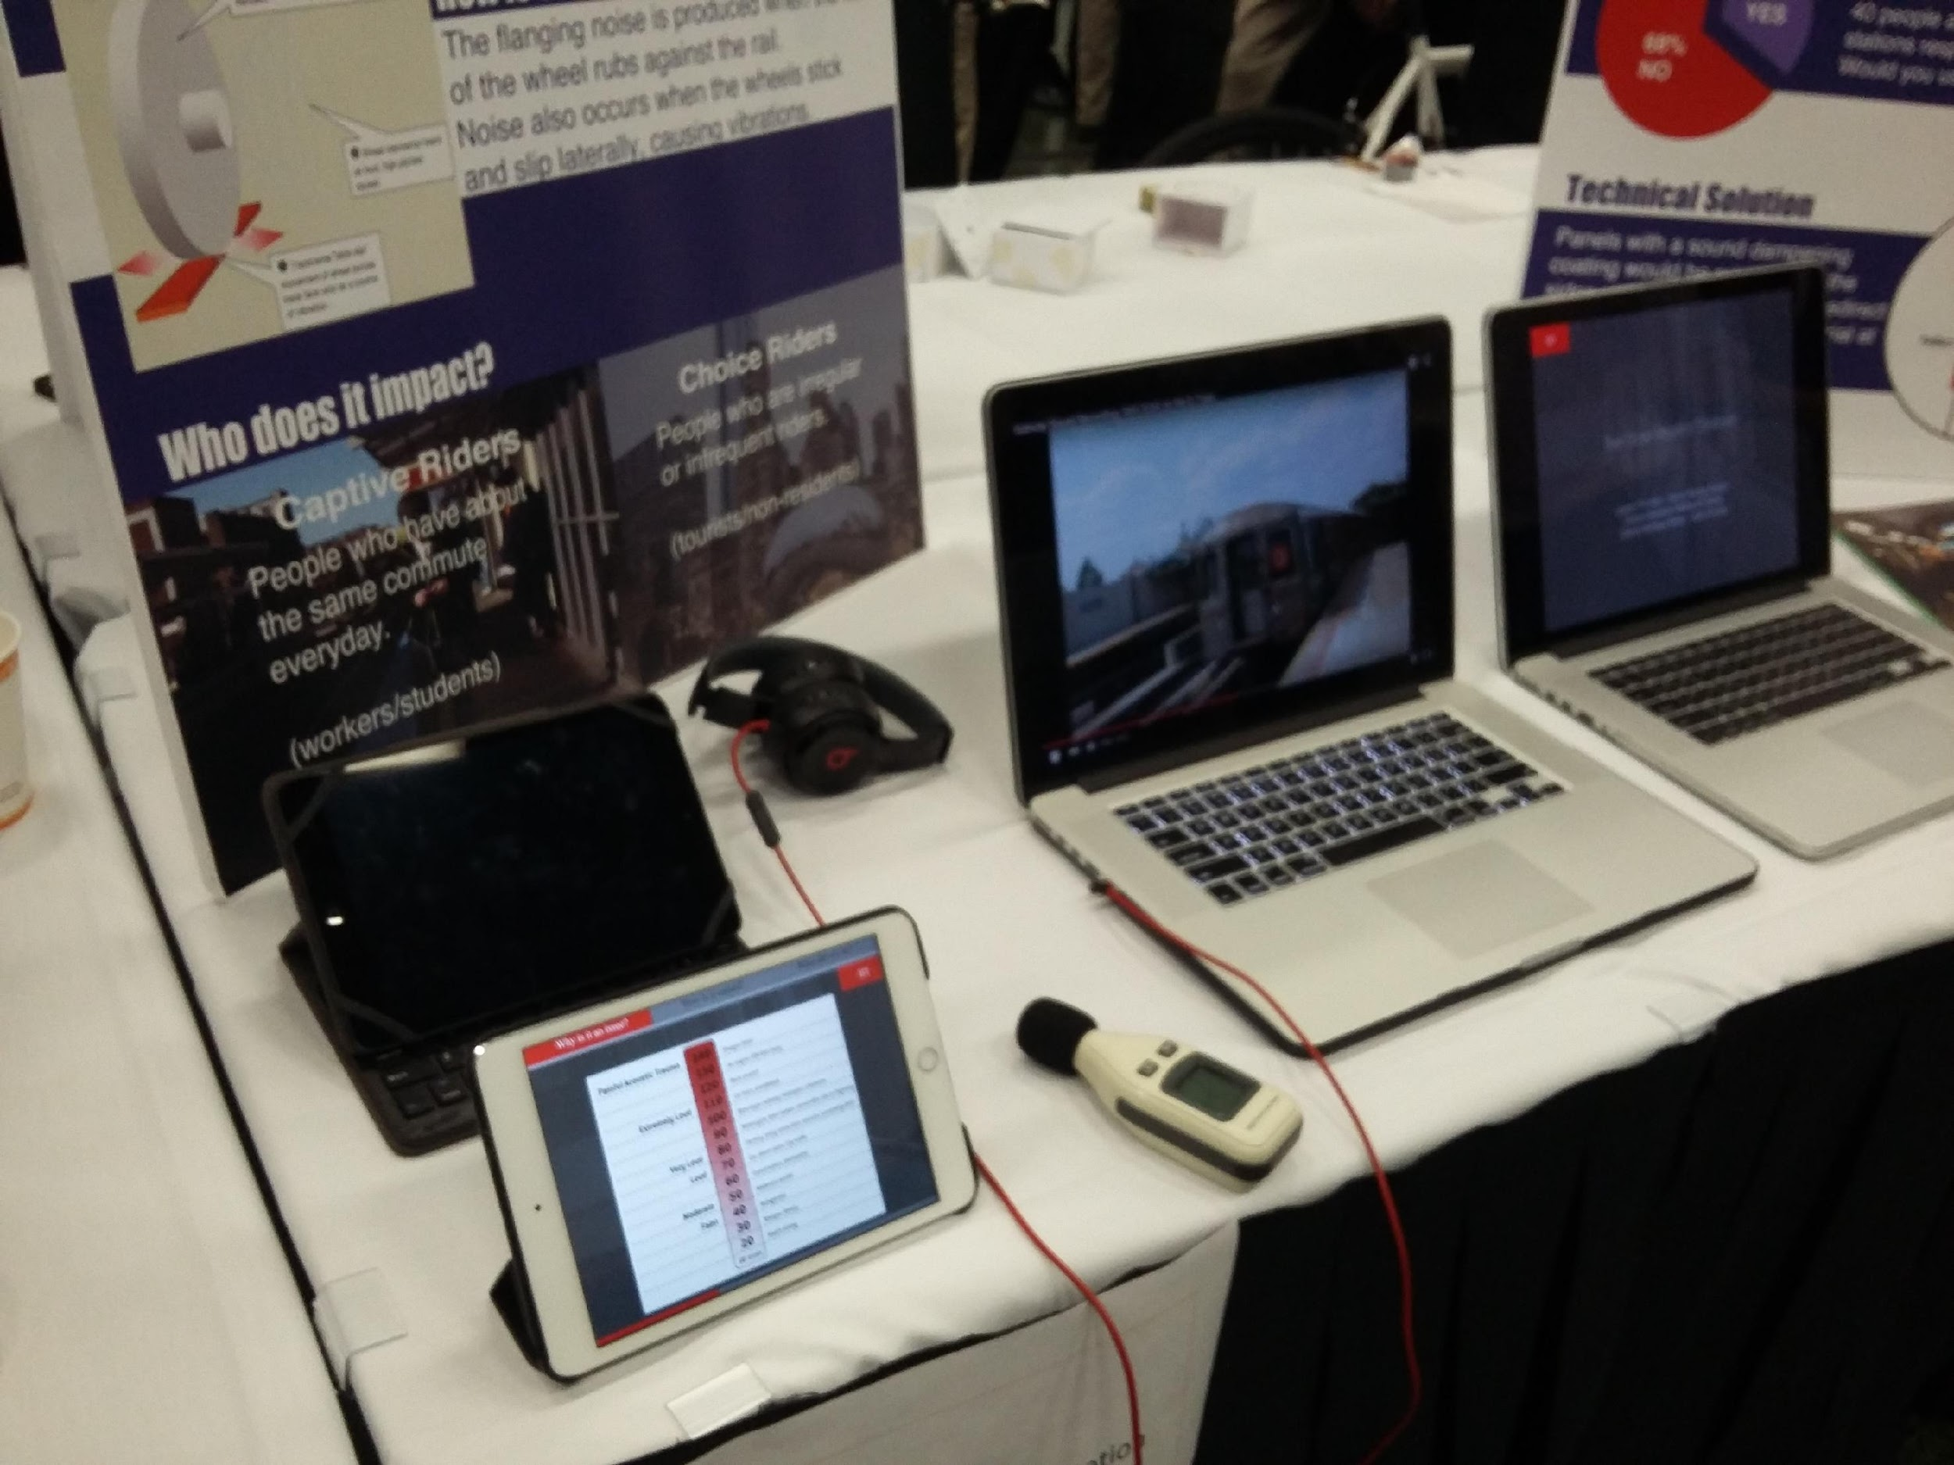

Slide 28
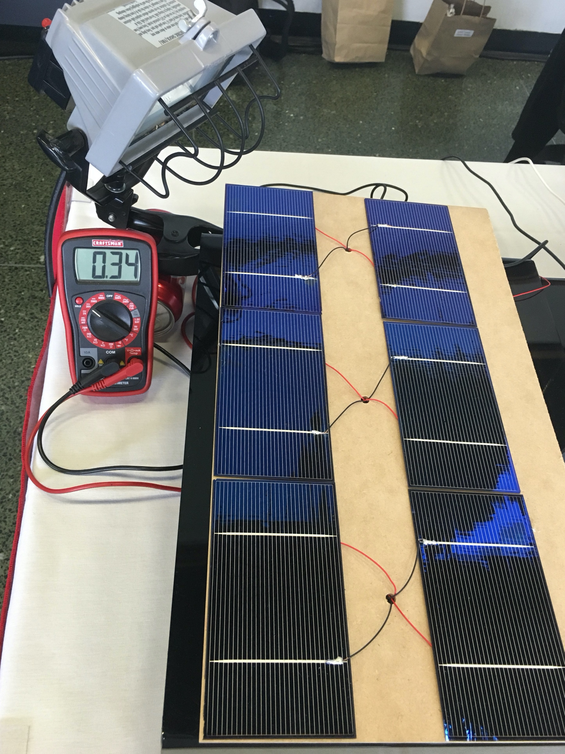
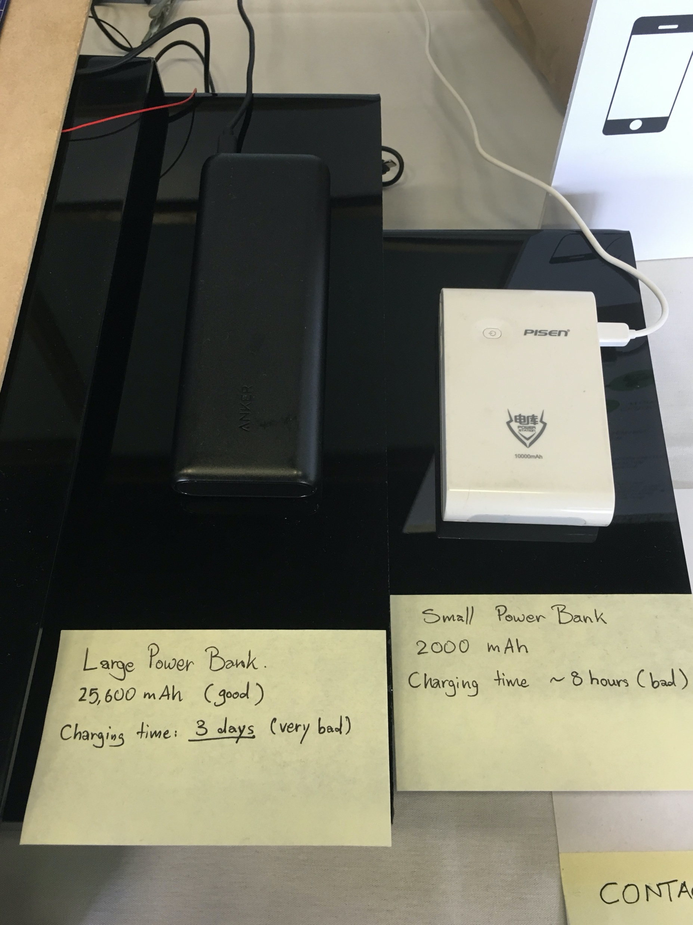

Slide 29
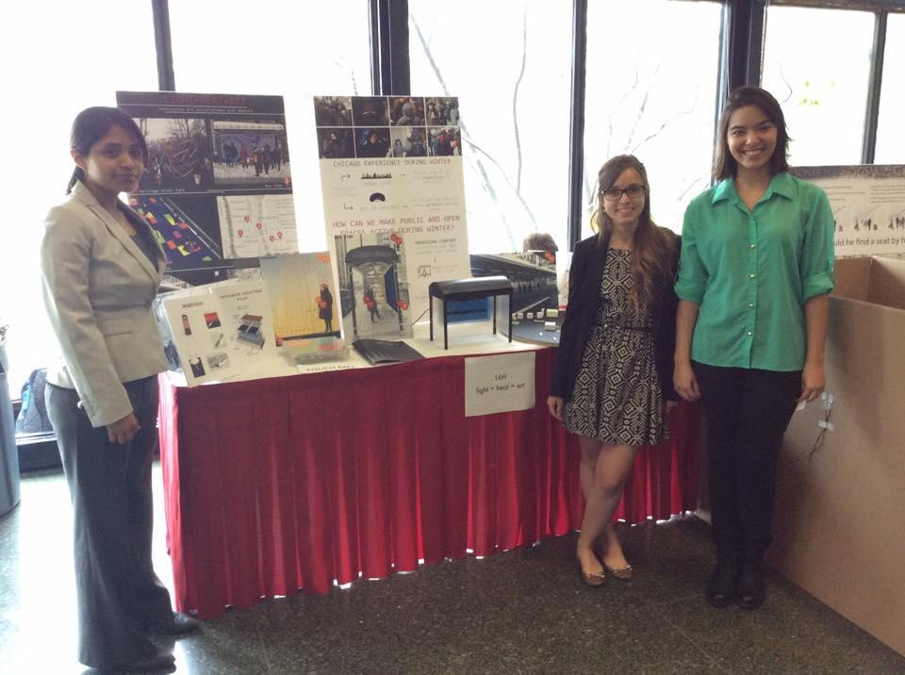

Slide 30
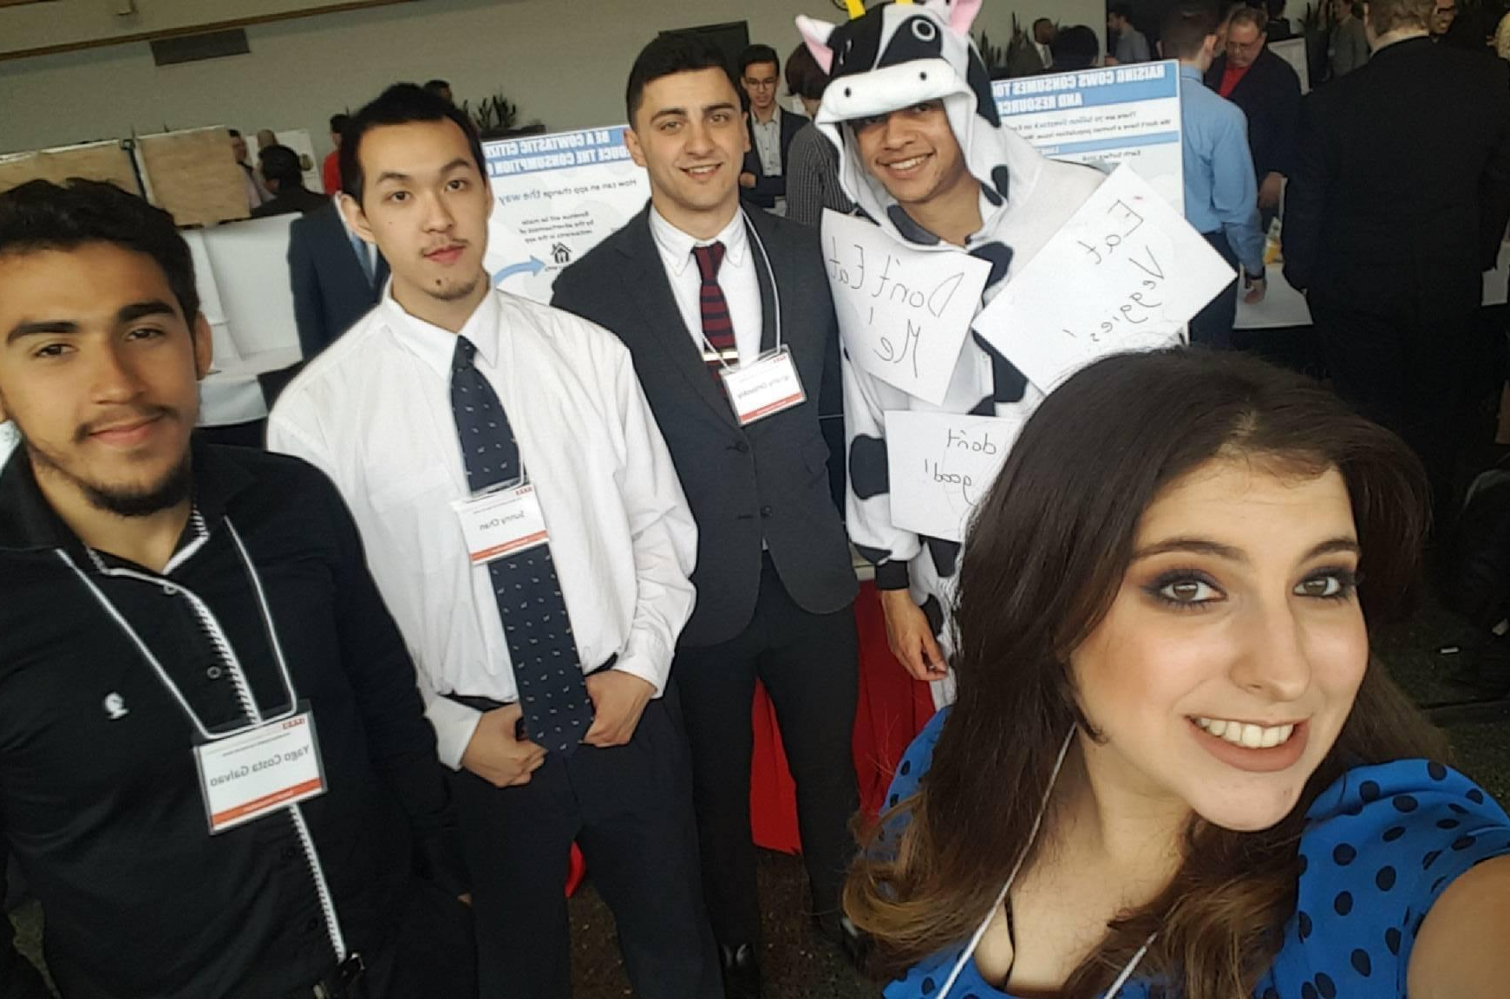
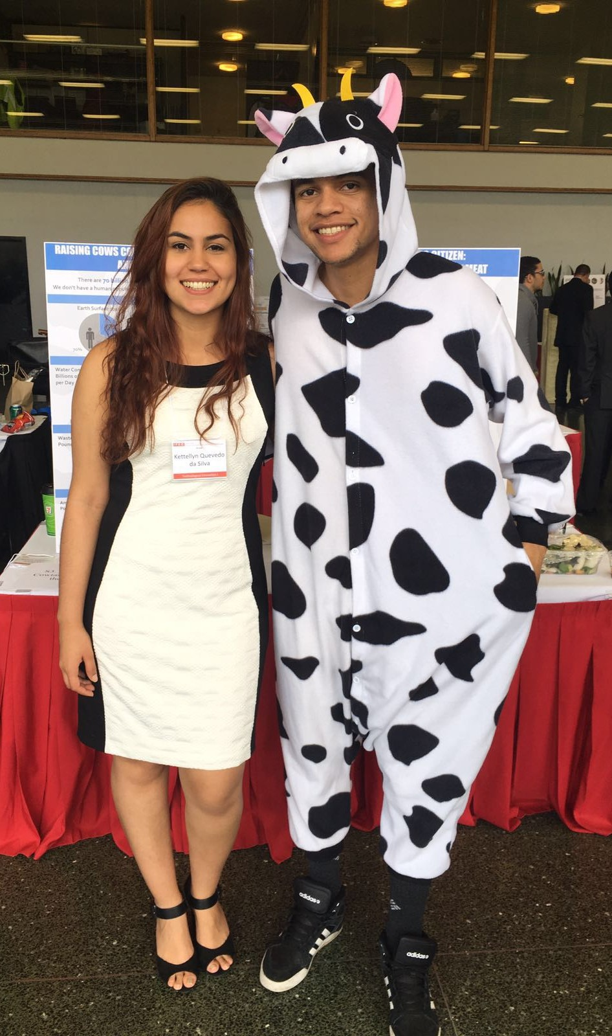

Slide 31
Quantitative Structure-Property Relationships
Today’s lecture is intended to help you achieve the following learning objective: Develop a model for a quantitative structure-property relationship. Describe its domain of applicability.
QSPR Topics
Machine learning
Features/descriptors
Algorithms
Validation
Limitations

Slide 32
QSPR is an application of machine learning
Machine learning [1]
“gives computers the ability to learn without being explicitly programmed” - Arthur Samuel (1959)
“A computer program is said to learn from experience E with respect to some task T and some performance measure P, if its performance on T, as measured by P, improves with experience E.” -Tom Mitchell (1997)
In Quantitive Structure-Property Relationships (QSPR)
Experience E: chemicals
Task T: predicting physical property, e.g.
boiling point, chromatography retention times
activity against a biological target = QSAR
ADMET (absorption, distribution, metabolism, and excretion - toxicity)
Performance P: correlation/error in validation set/real-world applications

Slide 33
Features/Descriptors
Enables chemicals to be input into machine learning models
How would you describe a chemical in numbers that can be put into a mathematical formula?
Features can be
from enumerable properties, e.g. number of a certain element, number of H bond donors/acceptors, presence/absence of an element functional group
based on 3D structures
of a chemical, e.g. surface area, radius of gyration, moments of inertia
of a protein-ligand complex
http://www.rdkit.org/docs/GettingStartedInPython.html#list-of-available-descriptors

Slide 34
Algorithms
Linear regression
y = mx + b for simple linear regression
y = m1x1 + m2x2 + … + b for multiple linear regression
x is projected onto a new space in partial least squares regression
Neural networks
sets of nodes that transform inputs into an output
allows for nonlinear relationships.
Deep learning
neural networks with multiple layers
increasingly popular and powerful with faster computers and larger datasets
Not an exhaustive list!
Diagram of an artificial neural network [2]

Slide 35
Validation
How do you know if a model is any good?
Data are split into training and test sets
Both sets should represent the same population
Model is built using the training set
Calculations on test set are compared to data

Slide 36
Limitations
What do you think some limitations of QSPR might be?
A high-quality training set is necessary
Models can only be applied to molecules similar to the training set
Sometimes small changes in structure can lead to large changes in a property
adding a methyl can make it so that a ligand no longer fits into a binding pocket
in QSAR, known as an “activity cliff”

Slide 37
References
[1] https://www.geeksforgeeks.org/introduction-machine-learning/
[2] Downloaded from https://commons.wikimedia.org/wiki/File:Colored_neural_network.svg and reused under the CC BY-SA 3.0 license

